Slide 1
Portfolio Risk Management Software
Nirali Shah
Zixuan(Shin) Liu

Slide 2
Introduction
Technology has revolutionized financial transactions. Now, one touch and you can probably conduct around 10,000 trades in a minute.
Arbitrage opportunities have always been fleeting and now with the advent of technology they dissappear at the speed of light.
This is where Financial software engineers come in. There are very few people who are equipped with a strong understanding of both finance and computer engineering.
As you may have guessed, with low supply and high demand this field has a lot of opportunities.
Stevens provides us the exceptional opportunity to collaborate with Quantitative Finance majors to work on the project.
Further , we have the opportunity to collaborate with OneMarketData, a financial software management and analysis company, to enhance functionality of their software, use it to model risk for a simple linear portfolio and then move on to more complicated models

Slide 3
Techical Information: Fundamental Description of the Design
A user interface where clients and construct simple portfolios and their risk preferences
Through the parameters they input the software can generate an appropriate maximum risk exposure (benchmark) of the portfolio.
The risk functions will be built on the ONETICK interface by OneMarketData

Slide 4
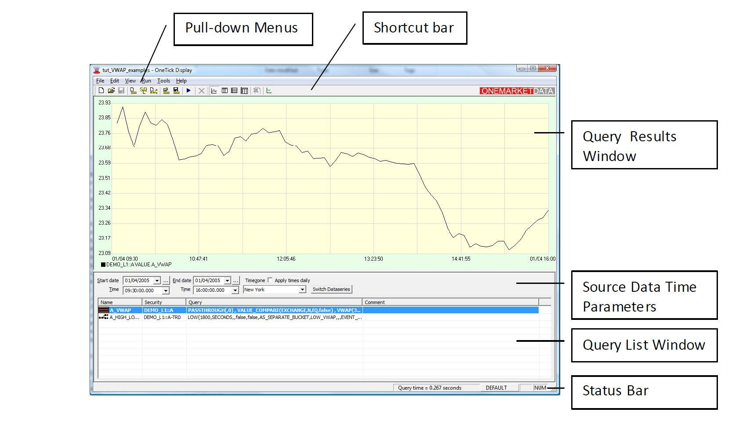
Techical Information: Fundamental Description of the Design

Slide 5
Technical Description of the Design
Interface
OneTick
Database/SQL
Modeling
VAR Model
Risk Preference Differentiating
Execution
C++/JAVA/Python for GUI
MATLAB for risk models

Slide 6
Mathematical Principles
A Bracket of Asset Returns
R(x) = R1x1 + R2x2 +· · ·+ Rn xn.
The set of possible asset allocations is defined as follows:
X = {x ∈ Rn : x1 + x2 +· · ·+ xn = 1, x j ≥ 0, j = 1, 2, . . . , n}.
The mean–risk portfolio optimization problem is formulated as follows:
maximize x∈X -> E[R(x)] − λυ[R(x)].
Here, λ is a nonnegative parameter representing our desirable exchange rate of mean for risk

Slide 7
Performance Expectations/Objectives
Objective: To assess risk exposure level for a given portfolio according to each clients’s unique preferences.
Performance Expectations:
Running time: Running time for each update should be less than 1µs.
Accuracy: Based on the client’s requirements, the software should be able to minimize risk and maximize return in accordance with the Markowitz Theory.
Efficiency: must run all day without crashing,
Cost: Priced less than or equal to market value initially to attract clients.

Slide 8
Background Information
Active Portfolio Management: A quantitative approach for Providing Superior returns and Controlling Risk
Investment Banking, Leveraged Buyouts and Mergers and Acquisitions
Combining Probability Distributions From Experts in Risk Analysis
KhanAcademy, Google Scholar and Wikipedia
OneTick Manual

Slide 9
Critical Evaluation of the Project
Good: This is a very good project because in spite of its complexities, it gives the team members an opportunity to gain valuable knowledge in this growing industry.
Scary: . Learning the company’s software, gaining an in-depth understanding of the finance required for this project, and implementing the knowledge into a C++ code will be the scariest part of the project.
Fun: Working with QF majors and crossing the bridge between finance and engineering will be fun.
Funding: Our project will be conducted with OneMarketData, therefore we will not require extra funding.

Slide 10
Summary
Objective is to enhance functionality of the company software, use it to model risk for a simple linear portfolio and then move on to more complicated models
Primary requirements is fast running time, high accuracy, efficiency and low cost
It is a collaborative project with OneMarketData and the team will either use their software or write a program using their software as a starting point
Student requirements: Basic knowledge of stochastic calculus, probability and statistics and essential financial concepts
Programming language: C++, MATLAB, Java, Python
Project is really interesting and the team looks forward to completing it.

Slide 11
References
http://www.palisade.com/devkits/rdk.asp
http://ezinearticles.com/?Matlab-For-Finance&id=3794670
http://www.mathworks.com/computational-finance/technicalliterature.html
http://www.springerlink.com/content/u03574n64401l7t1/
http://books.google.com/books?hl=en&lr=&id=e9GWUsQkPNMC&oi=fnd&pg=PA1&dq=Monte+Carlo+Simulation+Modeling+in+finance&ots=_m7BarXobZ&sig=-cz89TQk3c4jrY-0c2r4w54oN-w#v=onepage&q=Monte%20Carlo%20Simulation%20Modeling%20in%20finance&f=false
http://books.google.com/books?id=1aEoO2Y7PdsC&dq=Monte+Carlo+Simulation+Modeling+in+finance&lr=&source=gbs_similarbooks_s&cad=1
Dentcheva & Ruszczyński Portfolio Optimization with Risk Control by Stochastic Dominance Constraints
http://www.onetick.com/web1/

Slide 12
Questions
Q&A

