Slide 1
Wars in History
A look at the politics behind the Wars of the past
By Michael Cannito
Ronen Peled
Christina Sylvester

Slide 2
Introduction
All the data obtained in this report is from three years prior to a given war, the war itself, and three years after the war.
The four wars included in our analysis are World War II (1941-1945), The Korean War (1950-1953), The Vietnam War (1964-1973), and The Gulf War (1990-1991).

Slide 3
Questions to be Answered
Does War effect per capita income obtained through the GNP?
Does War effect poverty taking the Racial aspect into account?
Did the wars bring us out of deficit, give us a surplus, or plunge us into a bigger one than we already had?
Did War make us go into recession or pull us out of recession?
Is war profitable and beneficial to the American Economy through analyzing the GDP?

Slide 4
What we want to Conclude
Our main point is to deduce whether or not war is profitable through GDP to the American Economy using the answers obtained from the first few questions.
Our null hypothesis is that war does not affect the GDP and thus does not affect the economy
Our alternative hypothesis is that war does have an effect on GDP and thus does affect the economy through the questions that will be answered.

Slide 5
GDP
One of the national data points we will use to determine if war benefits the American economy is the Gross Domestic Product, or GDP
GDP measures the value of the goods and services produced by the U.S. economy in a given time period.
GDP is composed of goods and services that are produced for sale in the “market”– the generic term referring to the forum for economic transactions – and of nonmarket goods and services – those that are not sold in the market.

Slide 6
GDP Uses
Used by the White House and Congress to prepare the Federal Budget
The Federal Reserve uses it to formulate monetary policy
Wall Street uses it as an indicator of economic activity
Business communities use it to prepare forecasts of economic performance that provide the basis for production, investment, and employment planning

Slide 7
GDP Graphs and Analysis
This shows that US GDP has been almost always increasing from the year prior.

Slide 8
Graphs and Analysis II
This shows the % change in US GDP by year. Wars do impact the GDP as you can see by the spikes in the graph

Slide 9
GNP
The Gross National Product or GNP is the total dollar value of all final goods and services produced for consumption in society during a particular time period.
Its rise or fall measures economic activity based on the labor and production output within a country.
The tangible factors used to calculate this include, but are not limited to cars, furniture, bread, education, healthcare, and auto repair.

Slide 10
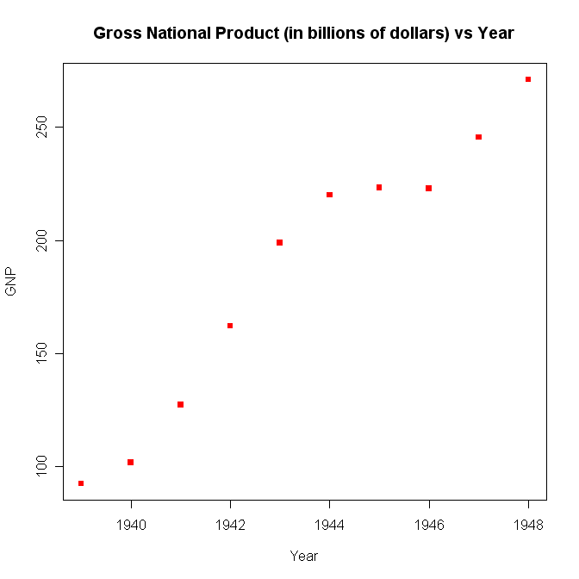
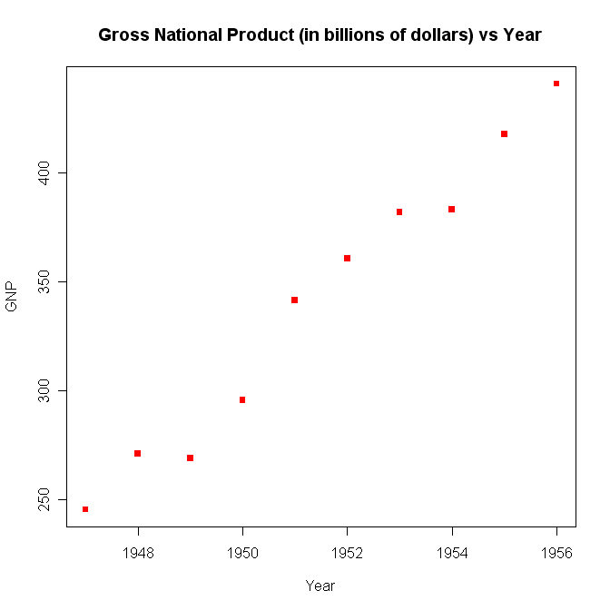
Gross National Product
Graphical summaries are presented below.

Slide 11
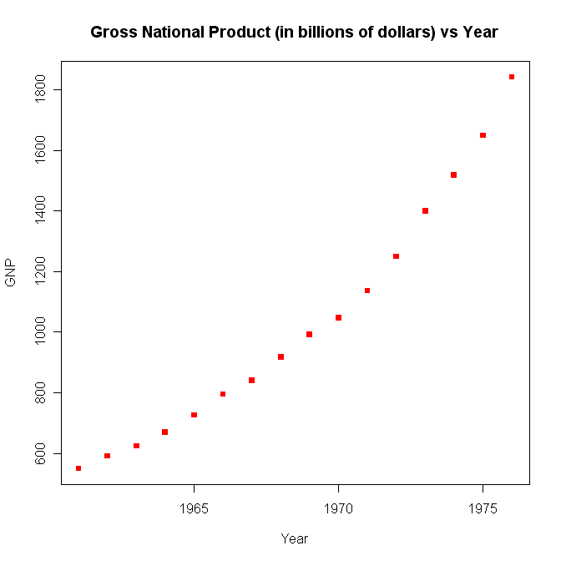
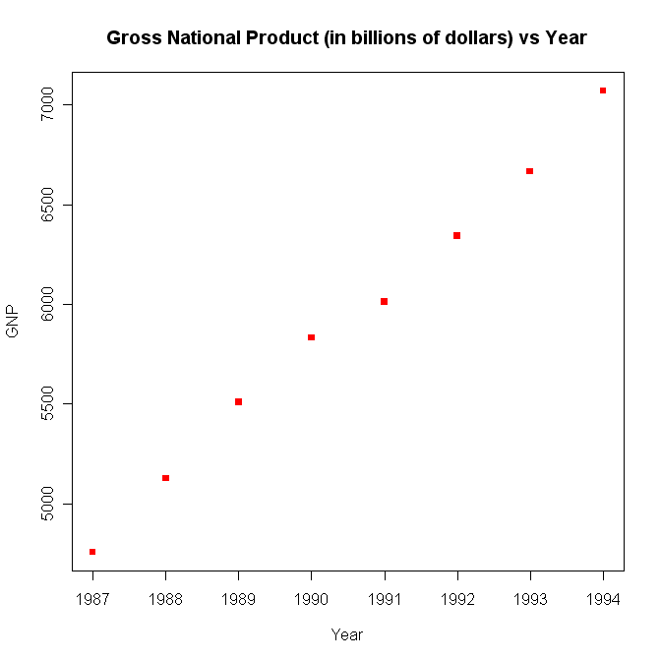
Gross National Product II
A continuation from the previous slide

Slide 12
GDP vs. GNP
A country's Gross Domestic Product, or GDP, is the amount of goods and services, measured at market prices, produced within the country during a particular time period (usually a year). Gross National Product, or GNP, is the amount of goods and services produced by residents of a country, regardless of where that production takes place.

Slide 13
Per Capita Income
Per capita income is the mean income computed for every man, woman, and child in a particular group.
It is derived by dividing the total income of a particular group by the total population.
It reflects GNP.
The factors that appear in per capita income include but are not limited to wealth as in the Euro or the U.S dollar, national income levels, and personal income for each individual person or home.
In all of these wars, you will see that Per Capita Income rises after during the war and peaks after the war.

Slide 14
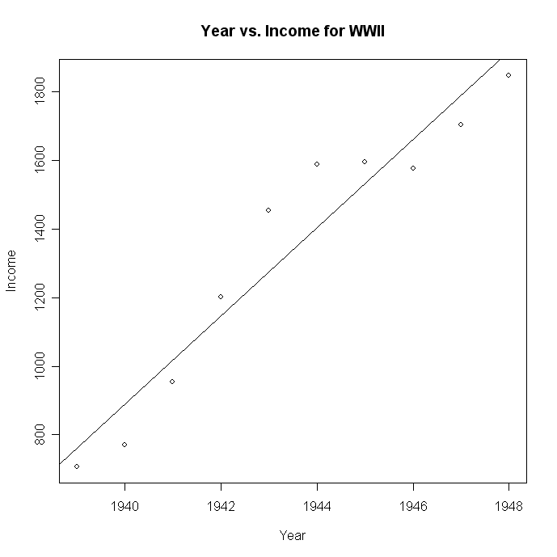
World War II
Simple linear regression to show increasing income

Slide 15
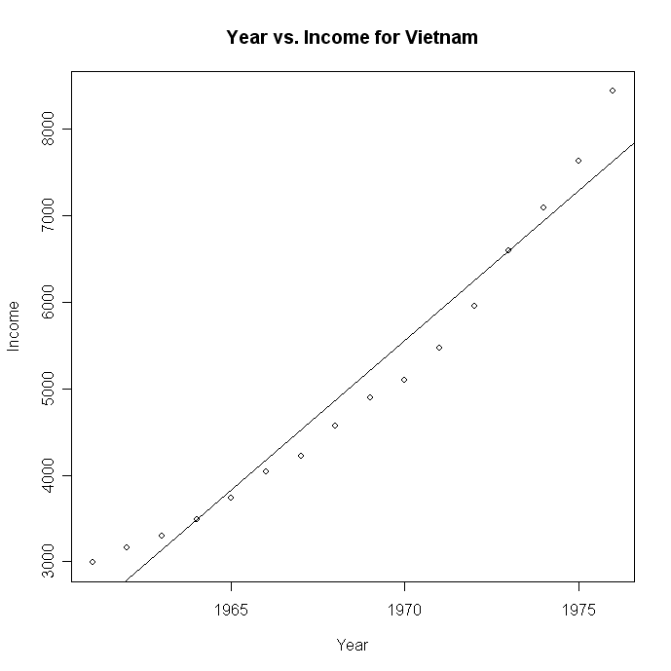
Vietnam War
Simple linear regression to show increasing income

Slide 16
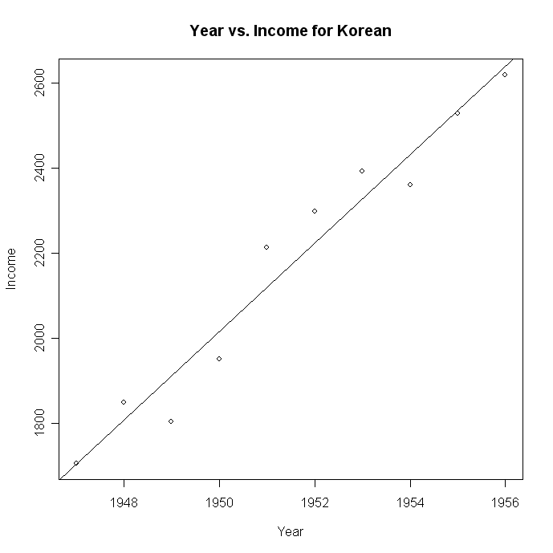
Korean War
Simple linear regression to show increasing income

Slide 17
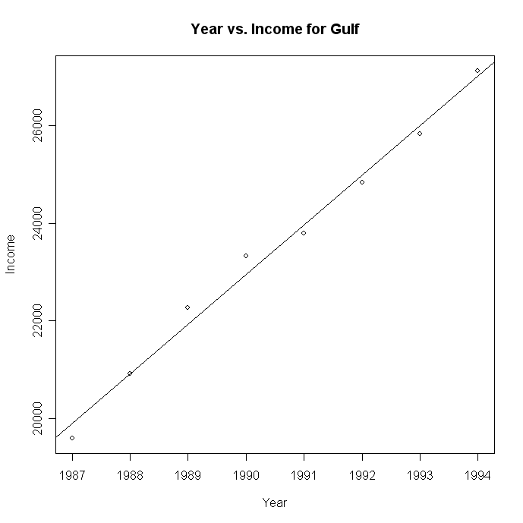
Gulf War
Simple linear regression to show increasing income

Slide 18
World War II
Multiple Linear Regression with Per Capita income as the response variable and all the others as explanatory variables
As you can see it is positively increasing linearly
This data is very good with the R value being 0.9882 and the p-value at 1.217*10^-5 which is significant.

Slide 19
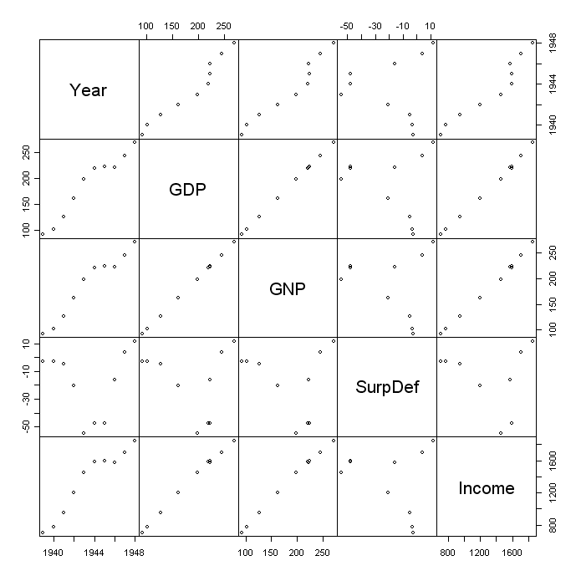

Slide 20
Vietnam War
Multiple Linear Regression with Per Capita income as the response variable and all the others as explanatory variables
Again, it is very linear with positive increases all around
We see that Surplus/Def does not go with the graph, but the surplus/deficit is very important for our study later on.
The R^2 value is 0.9807 with a p-value of 4.387*10^-10 which again shows very important significance.

Slide 21
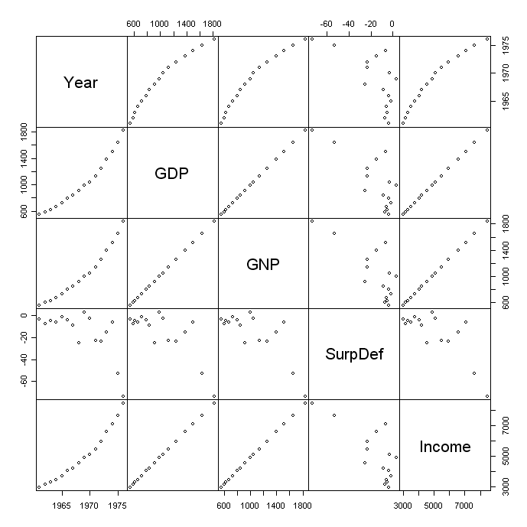

Slide 22
Korean War
Multiple Linear Regression with Per Capita income as the response variable and all the others as explanatory variables
It is the same explanation as above showing how per capita income increases as war goes on and eventually caps at a new high after the war is over
The R^2 value is 0.988 and the p-value is 1.262*10^-5 which is significant

Slide 23
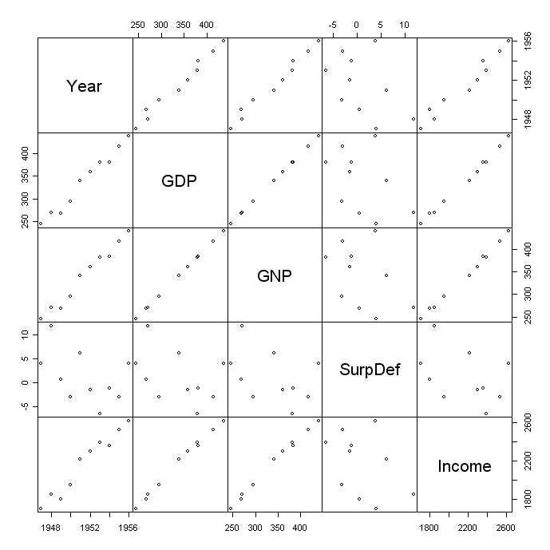

Slide 24
Gulf War
Multiple Linear Regression with Per Capita income as the response variable and all the others as explanatory variables
The same applies to the Gulf War also, Per Capita income increases as the war goes on to a new cap
The R^2 value is 0.9989 and the p-value is 2.469*10^-5 which is significant.

Slide 25
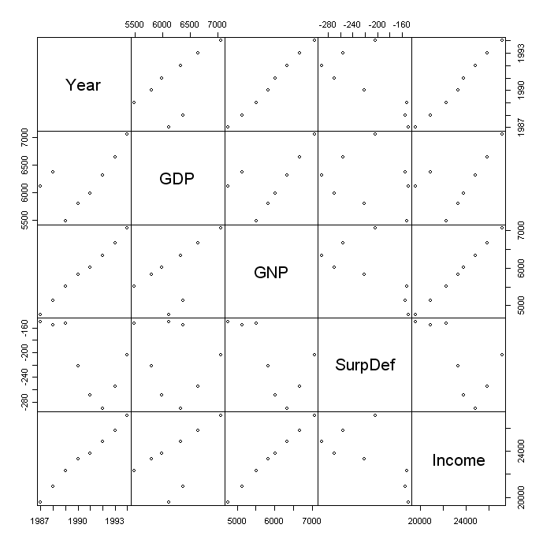

Slide 26
Conclusion Per Capita Income
As you can see from all of these slides using single regression and multiple regression that Per Capita Income increases with war and by the end a new cap is reached further bettering our society.
Even though as you will see later that Poverty and Deficit occur in times of war, it is also very profitable.

Slide 27
Poverty
Does America deal with greater Poverty in War?
The data for Poverty was only recorded on the federal level from the years 1959 and on.
What could be some of the reasons for this?
Did they realize that poverty is a contributing factor in war?
In proving our alternative hypothesis below that war is profitable, does poverty factor into that profitability or are we taking money away from the people who need it?

Slide 28
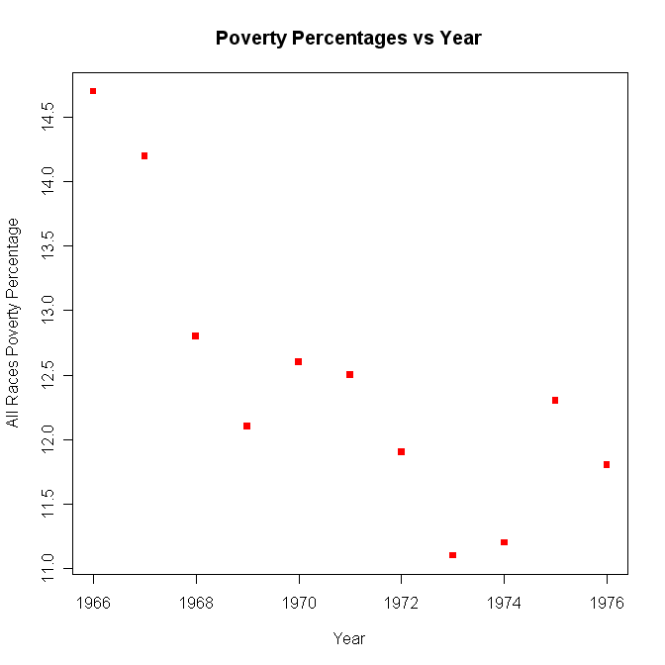
Poverty Overall in the Vietnam
The races in comparison in this war are African Americans vs. Caucasians vs. All Races

Slide 29
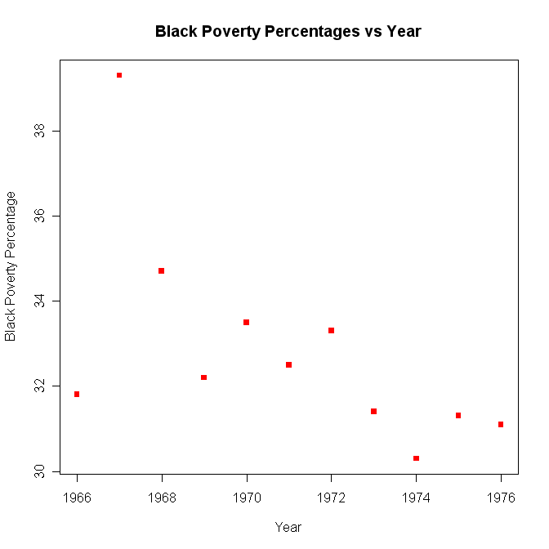
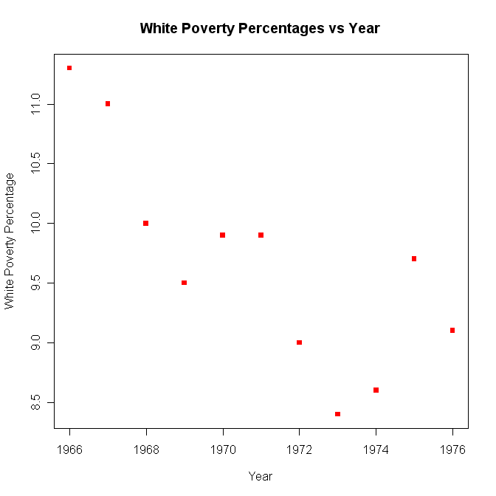
Vietnam War II
Racial Comparison in graph form

Slide 30
Racial Comparison in Vietnam War
This is a comparison to the national average
African Americans have greater poverty levels than whites throughout wars
The poverty level of African Americans compared to all races decrease while poverty level of whites increase compared to all races
The civil rights movement affects the race relations.

Slide 31
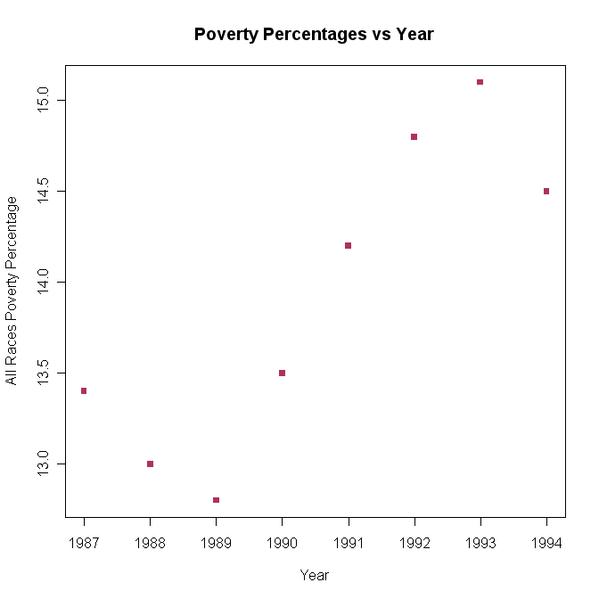
Poverty Overall in the Gulf War
Poverty exponentially growing for the Gulf War years

Slide 32
Racial Comparisons in Gulf War
This is the Poverty for a specific race and the conclusion made about them
African Americans increased throughout the war
Caucasian Americans increase d throughout the war
Hispanic Americans increases throughout the war
Asian Americans were scattered but overall decreased in the war
African Americans and Hispanic Americans are overall underprivileged minorities and have a deeper poverty level

Slide 33
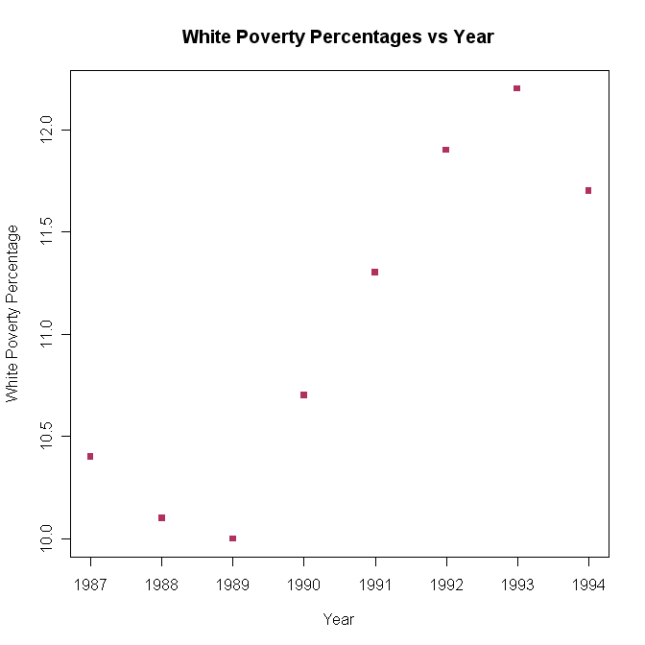
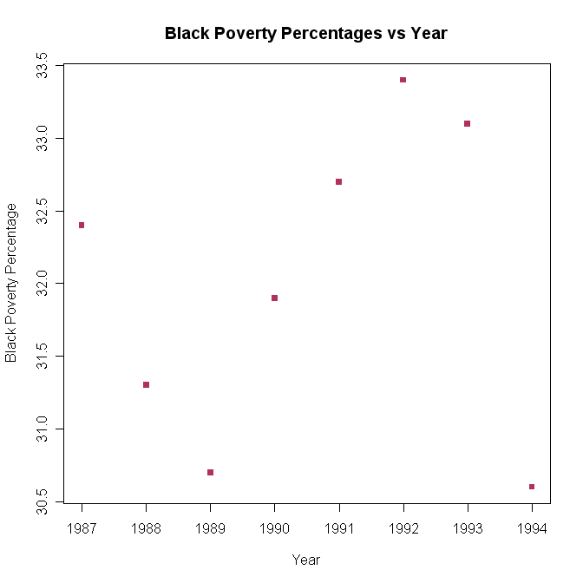
Gulf War II
Racial Comparisons in graph form

Slide 34
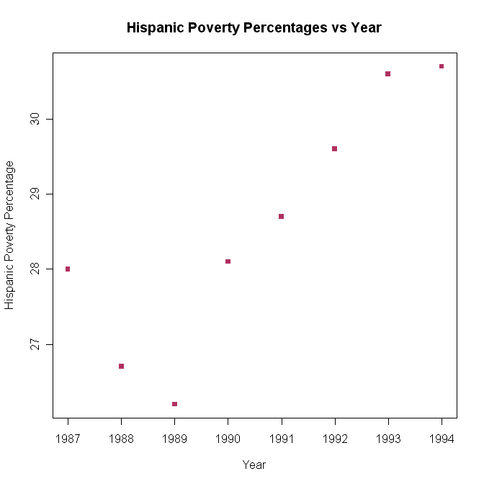
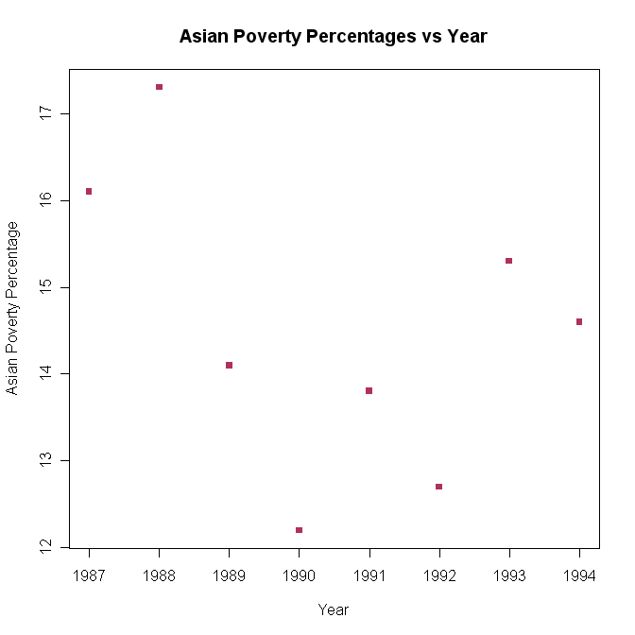
Gulf War III
Racial Comparisons II

Slide 35
Conclusion of Racial Comparisons
This is a comparison to the national averages
The African American poverty level decreases dramatically but still sits high in absolute terms, by more than double
The Caucasian poverty level increases but throughout the war is less than national average
The Hispanic poverty level decreases throughout the war but is more than double the national level
The Asian poverty level decreases and is about the same as the national level

Slide 36
Poverty Conclusion
Race is an influencing factor in determining poverty of a certain group.
Poverty is reflected by income, so if data were present on income by race, we could show a similar trend in income status by racial group for the gulf war and any other war presented with the right data.

Slide 37
Deficit
Deficit is when an entity (often the government) spends more money than it takes in.
Surplus is when an entity (often the government) spends less money than it takes in.
There are a few types of deficit that will be discussed and mentioned below
Trade Deficit
Deficit/Surplus

Slide 38
Trade Deficit
Trade deficit is the difference between exports and imports.
If trade deficit is <0, then we owe money and is very bad for the American economy.
For the first three wars, trade deficit grows during the wars and then recovers afterwards
For the Gulf War, trade deficit contracts. What factors could do this and shift the pattern?

Slide 39
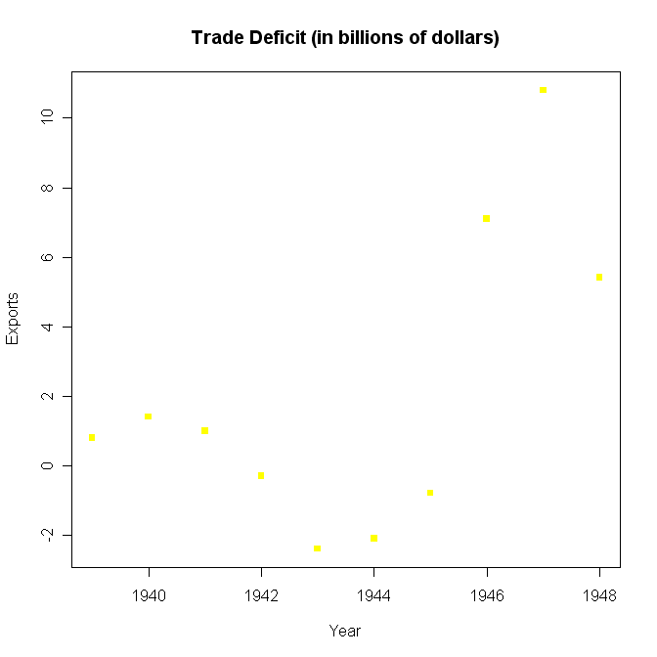
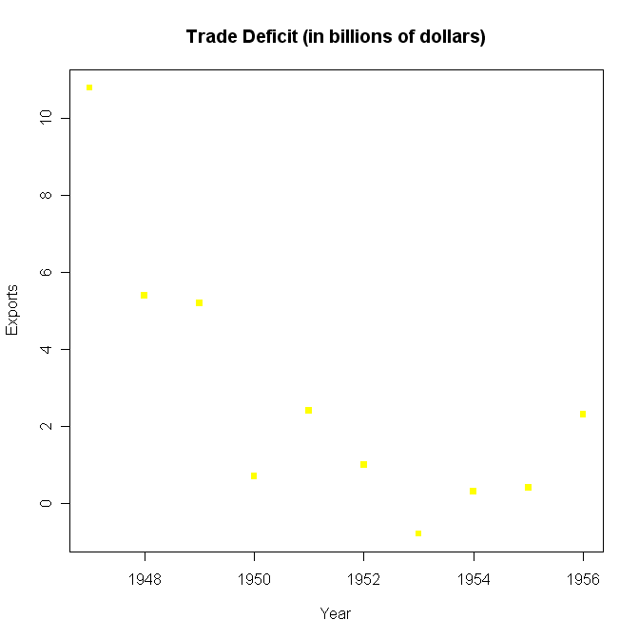
Trade Deficit Graphs
The graphs that support the analysis above

Slide 40
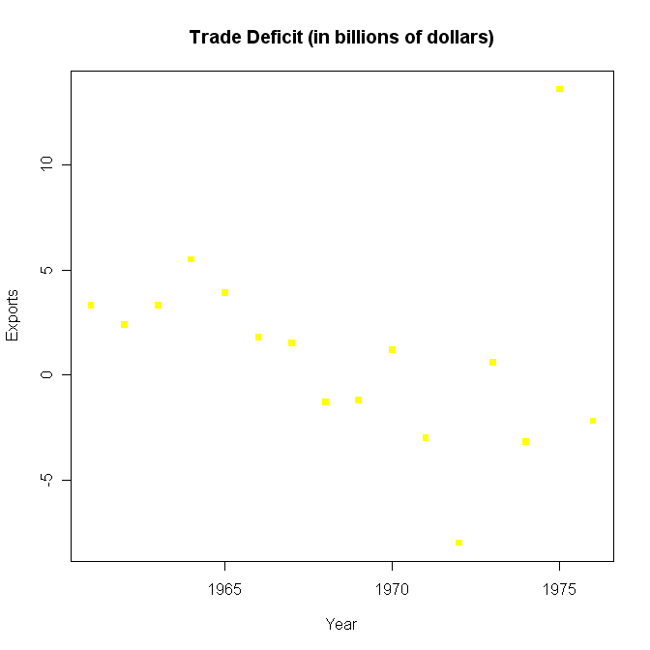
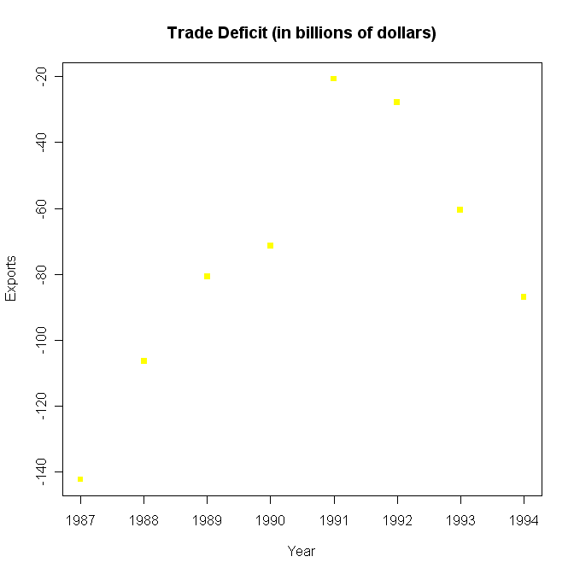
Trade Deficit Graphs II
Graph’s Cont’d

Slide 41
Surplus/Deficit
Surplus becomes a deficit or a current deficit becomes worse in war
By analysis, Vietnam follows similar behavior if you cut the war period of time in half.
The graphs are to follow.
Through the analysis below, we are plunged into deficit with war, but the war increases profitability including individual incomes which provides more for the populous. The national economy as a whole is also increasing through GDP, GNP, Per Capita Income, and eventually we come out of this deficit when the war is over.

Slide 42
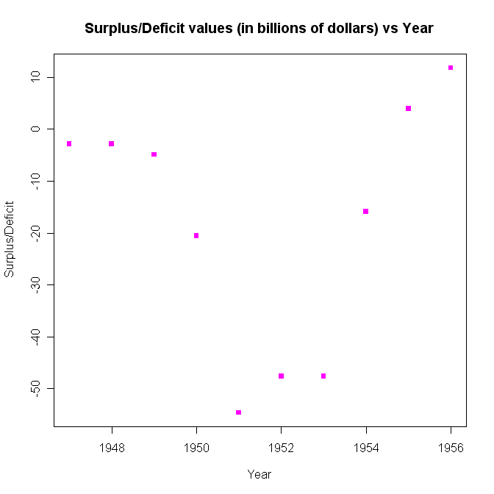
Graphs of Surplus/Deficit
The graphs are below

Slide 43
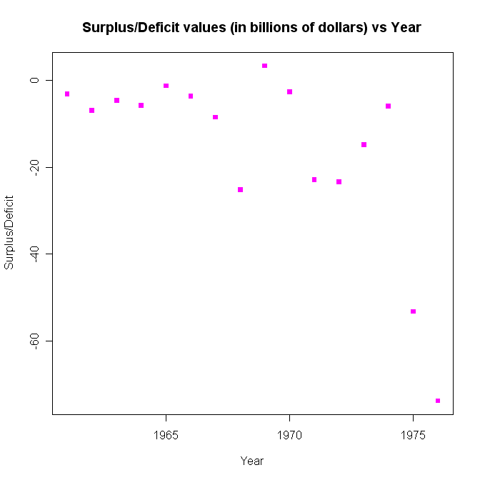
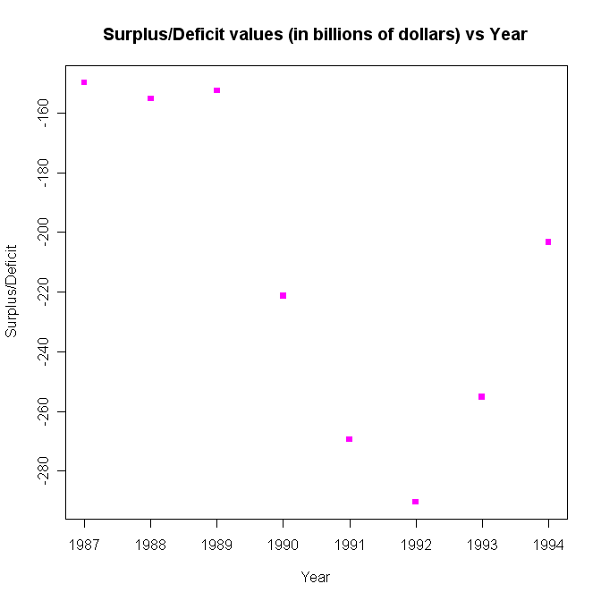
Graphs of Surplus/Deficit II
Graphs Cont’d

Slide 44
Recession
A recession is a decline in an country’s (GDP), or negative real economic growth, for two or more successive quarters of a year.
It is important to show at what times the US has entered recessions. If they seem to be common before, during, or after there may be a direct link between the two.
This will ultimately help with the final conclusion which is to fully support or not, the wars economically benefiting the economy.

Slide 45
A list of all the Recessions
1947q2 -0.5 1974q3 -3.8
1947q3 -0.2 1974q4 -1.6
1949q1 -5.8 1975q1 -4.7
1949q2 -1.2 1980q2 -7.8
1953q3 -2.4 1980q3 -0. 7
1953q4 -6.2 1981q2 -3.1
1954q1 -2.0 1981q3 -4.9
1957q4 -4.2 1981q4 -4.9
1958q1 -10.4 1982q1 -6.4
1969q4 -1.9 1990q4 -3.0
1970q1 -0.7 1991q1 -2.0

Slide 46
Analysis of Recession
22 quarters of the 304 quarters of the data is available
Only about 7.24% of the quarters the US was in a recession
Korean War brought us out of recession (1949); But put us back into one when it ended (1953-54)
Recession occurred for three quarters after the Vietnam War (1974q3-1975q1)
Recession also occurred during the most part of the Gulf War (1990-1991)

Slide 47
Analysis II
Eight quarters of the 22 are related to American Wars; Not including the recessions of the Korean War that may or may not have helped America exit out of.
36.36% of the American recessions are related to American Wars.
The many recessions in the 1980’s were caused by the tight monetary policy in the U.S. to control inflation and sharp correction to overproduction of the previous decade which had been masked by inflation.

Slide 48
Conclusion about Recession
We can theorize that war can bring a country out of a recession as seen through the data
It also causes it to fall into economic recession once it has ended, again, as seen through the data.
Do you think that war is worth the recession it brings us out of or plunges us into?

Slide 49
Is War Profitable?
We will try to analyze if war does affect the GDP and thus the overall economic situation of the U.S. It will show if the effect is positive or negative (GDP growth or decline).

Slide 50
World War II
Graphically and Mathematically are shown below.

Slide 51
World War II, II
Linearly Graphed with and without World War II

Slide 52
World War II, III
Through the graphs we see that for the actual GDP the data point is above the regression line and because of the R^2 value of 0.956 we have almost perfect correlation between data points.
Removing the WWII GDP data points from the set we see that the R^2 value increases which proves our alternative hypothesis and war does significantly impact the US GDP.

Slide 53
Korean War
Graphically and Mathematically are shown below.

Slide 54
Korean War II
Linearly graphed with and without the Korean War

Slide 55
Korean War III
The R^2 value with the R value is 0.976 and shows a positive influence on the GDP as shown in World War II
Calculating the GDP without the war increases the R^2 value and concludes that war did have a positive effect on the US GDP.

Slide 56
Vietnam War
Mathematically and Graphically are below.

Slide 57
Vietnam War II
Linearly graphed with and without the Vietnam War

Slide 58
Vietnam War III
This is the first war that the U.S. had actually lost so the graphs are very fluctuant because of this fact.
The GDP actually falls below the regression line with the Vietnam War, but nonetheless has a R^2 value of 0.950
Without the war the R^2 value has increased thus confirming our alternative hypothesis.
Even though GDP fell below the regression line we conclude that the economy still benefited from this war.

Slide 59
Gulf War
Mathematically and Graphically are shown below.

Slide 60
Gulf War II
Linearly Graphed with and without the Gulf War

Slide 61
Gulf War III
This was one of the shortest wars in history which means it had a much smaller impact on the GDP and the U.S. Economy.
With the war the R^2 value is 0.995 and without it, it jumped to 0.997 thus confirming our alternative hypothesis that the war does affect GDP even if it only be a small amount.

Slide 62
Conclusion about Profitability
This data suggests that the American wars do contribute to the U.S. economy via the GDP in this case.
This is always a positive manner but sometimes does not seem to outpace what the economy could have produced without the war.
War is profitable based on GDP and just think where we would be without it.

Slide 63
Conclusion
After answering all the questions we realize that war is profitable through a positive correlation and yet puts us into a deficit, but we eventually get out of it.
We reject our null hypothesis and keep our alternative hypothesis, thus confirming what we believed the whole time.
Any Questions…

