Slide 1
Aromatic Acylation with Cyclic Anhydride for Plasticizer Production
ExxonMobil Research and Engineering Company
Peter Campbell, Karol Oldziej, Paul Wyka, Alex Gutwillig, Anthony Campesi, Andrew Accardi

Slide 2
Patent Description
To produce a high performance plasticizer
Increases flexibility and workability of plastics
Used in PVC, sealants, vinyl products, etc.

Slide 3
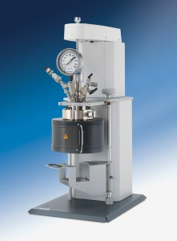
Introduction
In a Parr reactor HCl was added with OXO-C₉ Benzoylbenzoate Ester, OXO-C₉ Benzoylpropionate Ester or DINP.
Temperature maintained between 91 and 104 degrees Celsius inside the batch for 33 days.
Throughout the process, GC sampling was performed for monitoring of conversion.

Slide 4
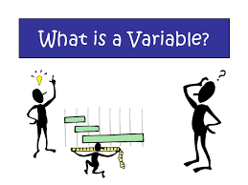
Process Variables

Slide 5
Process Variables
The simulation consists of:
Controlled Variables: Temperature and reactant input
Manipulated Variable: Jacket coolant flow
Disturbance Variable: Random temperature fluctuations, including heat of reaction
Final Output: Reactant conversion and temperature profile

Slide 6
Transfer Functions
Above transfer function taken from relevant literature and modified for our situation
Below transfer function was developed from graphical output of conversion weight percent

Slide 7
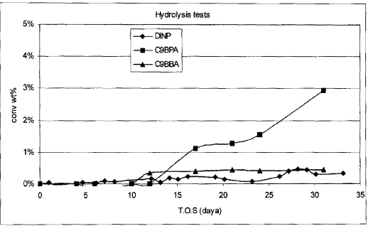

Slide 8
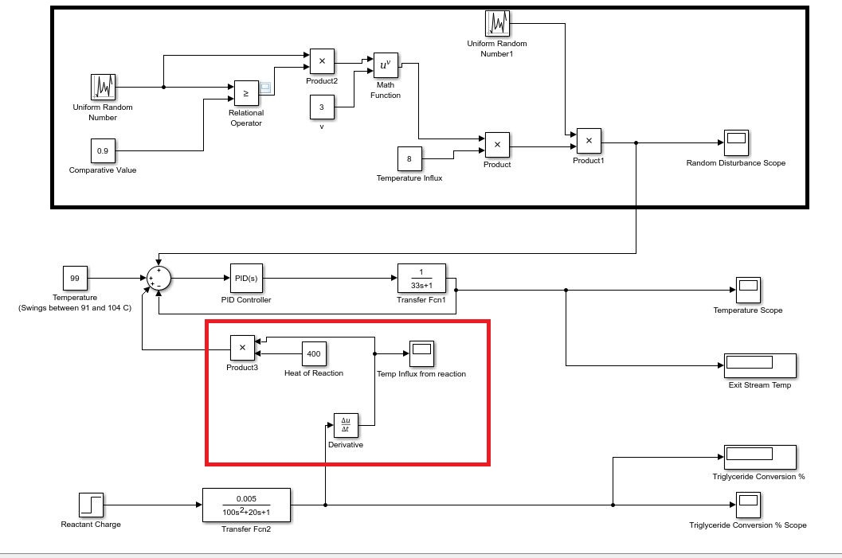

Slide 9
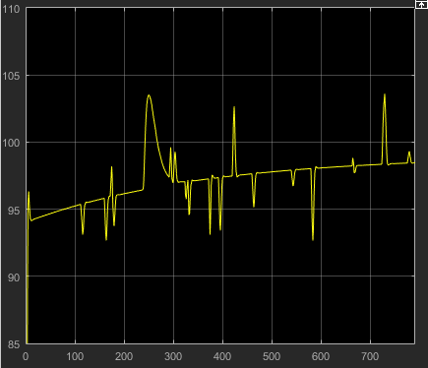
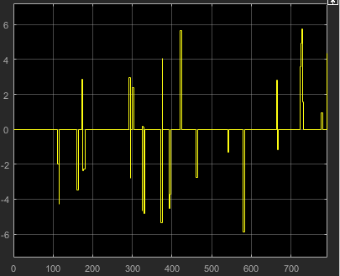
Random Disturbance Generator
Temperature vs Time

Slide 10
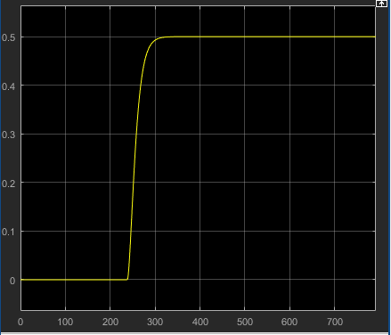
Triglyceride Conversion %

Slide 11
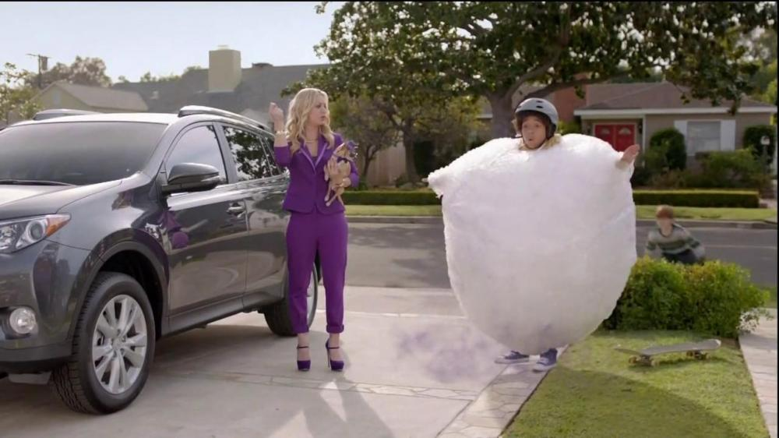
SAFETY

Slide 12
Safety Features
The process is exposed to high temperatures and high pressures.
A cooling jacket installation to monitor temperature and vary flow of coolant.
Pressure indicators at high pressures can signal plant operators to relieve pressures by opening a valve.
If pressures are too high to indicate catastrophic failure or if no operator is around, installation of rupture disks would automatically release pressure.

Slide 13
Conclusions
Our model reflects the conversion weight percent similarly to the graph shown on the patent.
Our model includes disturbances in temperature from ambient conditions and reaction inside the reactor.
Had we were given more time, a second-order function could have been developed to provide a more realistic scenario.
Instead, our transfer function was estimated to resemble the patent provided.

