Slide 1
Thermoformable Conductive Ink:
Thermoformable Polymer Thick Film Transparent Conductor and its Use in Capacitive Switch Circuits
ChE-345 Group 3 Final Project
Brianna Evans
Jonathan Karkoska
Nicholas Minervini
Morgan Mostow
Emily Olsen
Julia Smith
Victoria Taibe

Slide 2
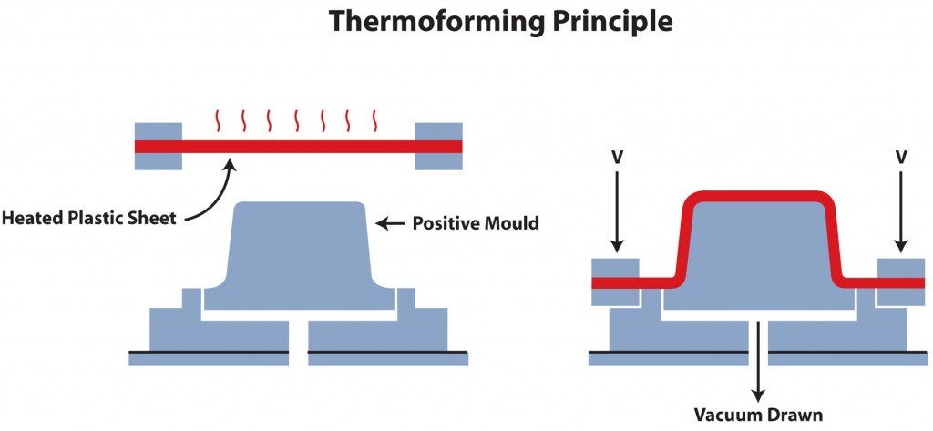
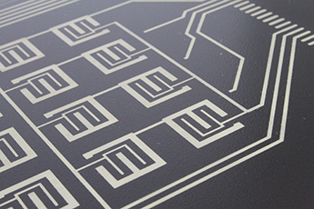
The Patent
Conductive PTF circuits are used as electrical elements, but there are issues with conductivity and compatibility of substances
Layer of conductive ink is printed and dried on a substrate to produce a functioning circuit that is thermoformed
Can be used on substrate of choice OR as part of capacitive circuit stack with silver
THERMOFORMING: subject to pressure & heat that deforms the circuit to its desired 3D characteristics
Notes:
This invention solves problems with conductivity and compatibility of substances
Ability to be thermoformed is what makes this patent unique
Conductive ink deposited between protective layers of organic media - allows it to be heated and mechanically treated

Slide 3
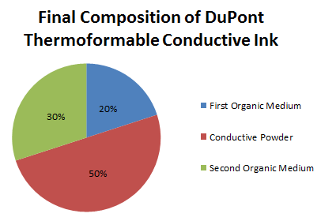
Example 1
20 wt% Organic Medium 1
20 wt% Desmocoll 540 polyurethane
80 wt% dibasic esters organic solvent
Heated at 90º C for 1-2 hours
50 wt% ITO powder added to OM1
0.25 wt% printing additive
30 wt% Organic Medium 2
27 wt% PKHH polyhydroxyether resin
73 wt% dibasic esters
Heated & mixed
Combined & heated 30 minutes on a planetary mixer; several passes on three-roll mill
Lines printed, dried, and thermoformed
Notes:
Team 3 used Example 1 from the patent to model the mixing of the conductive ink
Each of these components is made as an intermediate, then mixed together in the proper proportions at the end
The composition was mixed for 30 minutes and subjected to several passes on a three roll-mill before being printed for circuit fabrication

Slide 4
Overall Schematic
Resin 1
Conductive Powder
Solvent 1
E
Product
A
Organic Medium 1
C
Resin 2
Solvent 2
Organic Medium 2
B
D
Notes:
Specifically modeled A and C which are heating and mixing of conducitive powder
B and D are same with different numbers

Slide 5
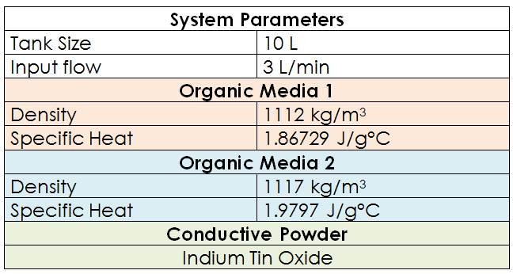
Model Specifications/Parameters
Notes:
Don’t need a lot of ink for the process
Why we need these values and how we got them
Didn’t model the conductive powder because we didn’t have to make it

Slide 6
Transfer Functions
We assumed:
steady state
Constant volume and density (overfill line)
Incompressible liquids
Perfect mixing
Constant specific heat
Mixing: observe how the flow rate affects the final concentration of the resin that was created while mixing
Heating: the heat input will affect the final temperature of the final solution
Using heat and mass balances we were able to derive a 1st order transfer function for the mixing and heating systems in the simulink model
Notes:
relate the output to the input
our system was unique because We needed two separate functions one for mixing and one for heating
Using the assumptions, mole and mass balances and LaPlace transforms we were able to find the Transfer functions for each Heating and Mixing to solve for K and Tau to input those values into our simulink model

Slide 7
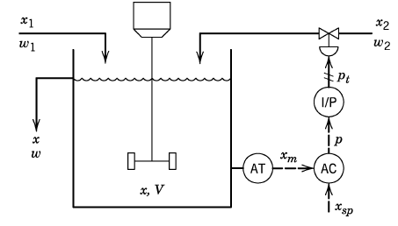
Transfer Functions: Mixing
Mass Balance:
Mole Balance:
Linearized differential equation:
Final Transfer Function:
Notes:
After the chain rule and substitution were applied we used linearization to derive first order transfer function

Slide 8
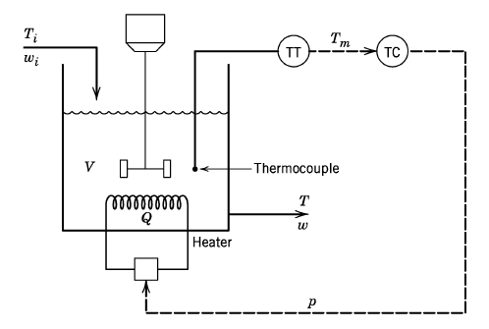
Transfer Functions: Heating
Steady State:
1st LaPlace Transform:
2nd LaPlace Transform:
Input Temperature Constant:
Final Transfer Function:
Notes:
K=gain
Tau= time constant
Mixed for 1-2 hours and heated at 90C
used to dissolve all the resin in the first organic medium
Second organic medium was mixed and heated before being added to the first and mixed for 30 minutes

Slide 9
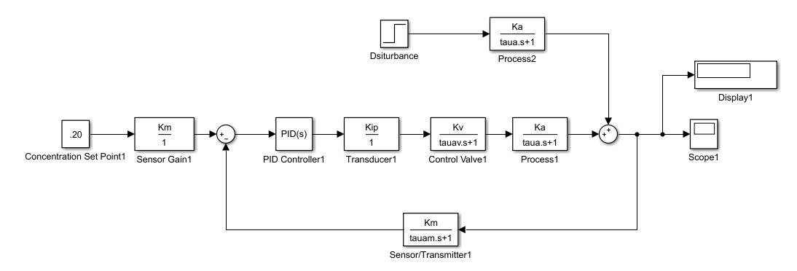
Model

Slide 10
Model - Mixing Process
Disturbance

Slide 11
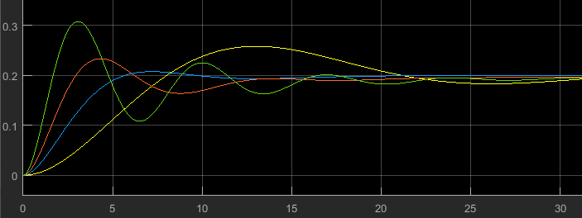
Tuning
Controller Gain Delay Trials Displayed:
1 5 10 20
Controller Gain Chosen: 4.1

Slide 12
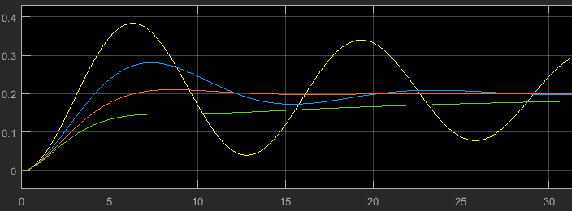
Tuning - Integral Time Delay
Integral Time Delay Trials Displayed:
.25 .5 1 3
Integral Time Delay Chosen: 1.1

Slide 13
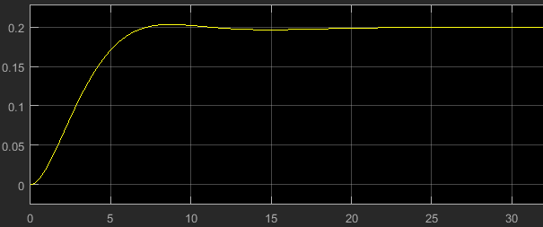
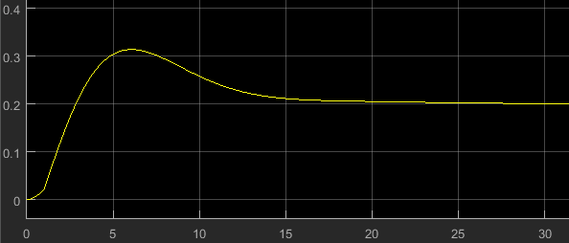
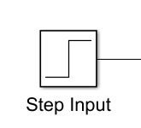
Tuned Model Behavior
- Step Disturbance Response

Slide 14
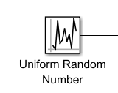
Tuned Model Behavior
- Random Disturbance Response

Slide 15
Model - Heating Process
Disturbance

Slide 16
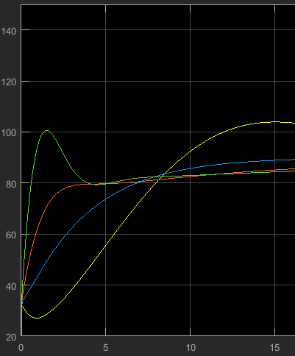
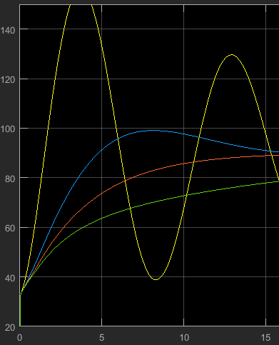
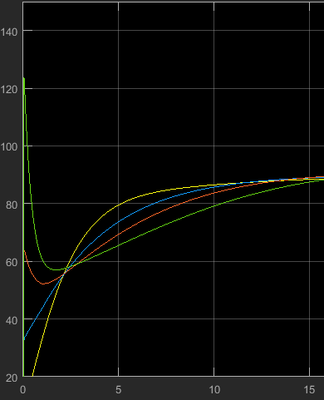
Tuning Model Behavior

Slide 17
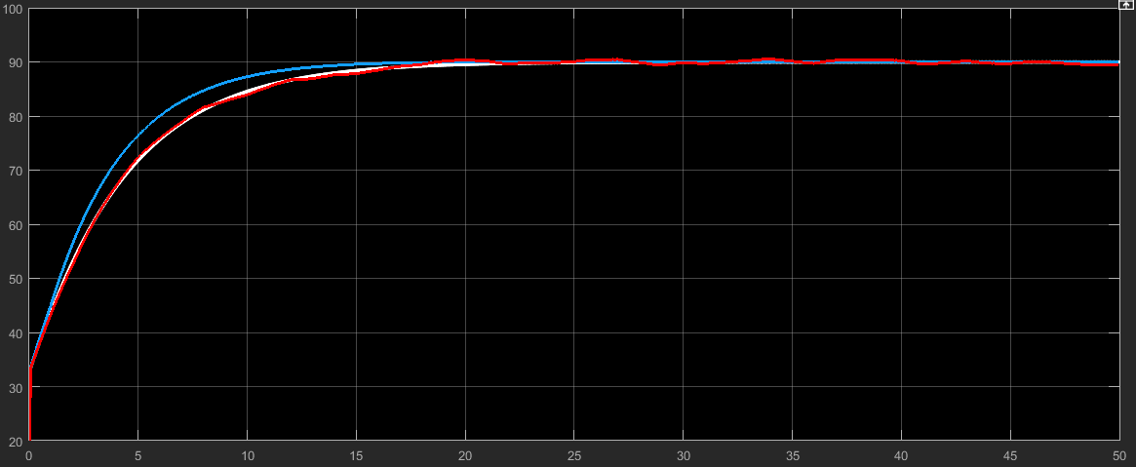
Tuned Model Behavior

Slide 18
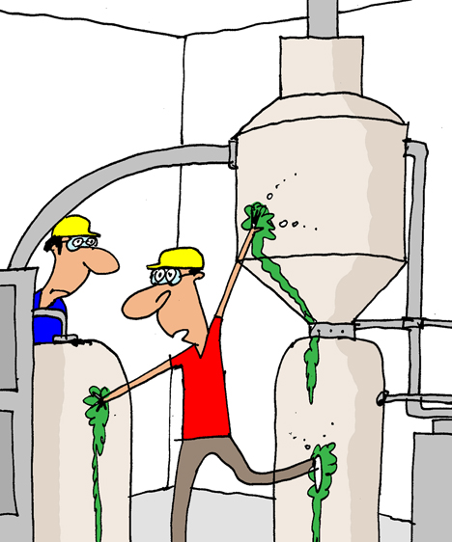
Safety Features
Pre Start-Up Safety Review (PSSR)
Overheating
System shuts down at a certain temperature
Overpressurizing
Safety valves
Lost power/air
Fail open/fail close valves

Slide 19
Conclusions
Learnings
Exposure to patents
Industrial applications of process modeling
Making reasonable assumptions
Further Development
Specifications for equipment and instruments
Model process to manufacture ITO powder
Optimization and efficiency
Questions?
Notes:
ultimately the team gained exposure to patents as well as commercial applications of process modeling software
the course helped with deriving transfer functions and tuning them to accurately portray real time data
moving forward the team would like to get specifications for equipment/instrumentation
also we could model the process of manufacturing the conductive power
and finally the last step would be process optimization for throughput and efficiency

