Slide 1
Effects of Regulation on Gun HOMICIDE
By Sean McCoy, Vincent Lipoma, Robert Hoffmann, Sean Mullaney

Slide 2
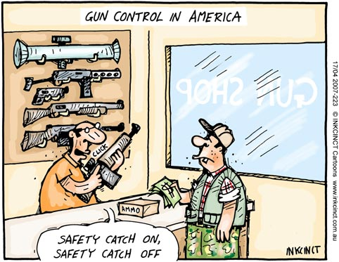
Purpose
Theory: Does firearm regulation have an effect on firearm-related homicide?
“…analyze gun-related homicide data per state in the United States, and determine whether or not a state requirement for a permit to purchase or forced registration of a gun impacts the gun-related homicide rate in certain states”

Slide 3
About the study
Primarily handgun-focused
All other firearms have a very low death rate
Could not include DC/Florida
Insufficient data
Other questions to consider
Non-gun related homicide: Do states with more restrictive firearms control have higher non-gun murders in general?
Is there a difference between handgun murder and other firearm murders?

Slide 4
Sources
Federal Bureau of Investigation (stats)
United States Census (population)
National Rifle Association (regulation)

Slide 5
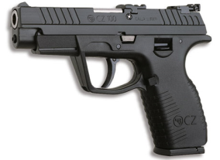
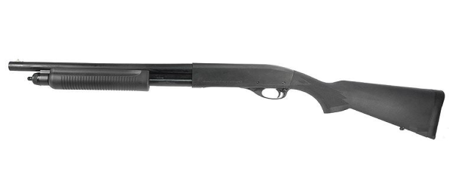
Firearm Terms
Weapon Terms:
Handgun
Shotgun
Long gun
Other
(and also illegal)
Legal terms:
Permits
Registration
Notes:
Gun types
What is a permit?
license: a legal document giving official permission to do something
State issued
What kind of permits do I need for firearms ownership?
Permits for getting a gun (NJ):
Permit to Purchase a Handgun
ID
Firearm owner ID card
Firearms Purchaser Identification Card
Registration: Voluntary in some states, allows the government to track weapons

Slide 6
Our data (per state, 2008)
Total Murders
Total Murders by Firearm Type
Handgun, shotgun, rifle, unknown
Other Murders
Knives/cutting instruments
Hands/fists/etc
Population
Proportion of each murder type to population
Restrictions
Notes:
From the NRA and FBI factsheets

Slide 7
Testing
Methods
T-Test
One-way ANOVA
Multivariate ANOVA
Regression Modeling

Slide 8
Test Results
Handgun permits being required significantly reduced handgun related murders.
Registration on its own has no significant effects on handgun related murder.
Handgun permits being required reduces overall proportion of murders to population (sorry NRA!)
We did not observe an effect of increased gun restriction relating to higher non-gun murders.

Slide 9
‘Considerations’
Lurking variables?
General crime rate (per state)
Poverty
Urbanization
Other potential variables in model
Only 1 year (2008)
We will consider other years and trends
To prove: Does gun regulation reduce overall crime (not just murder)?

Slide 10
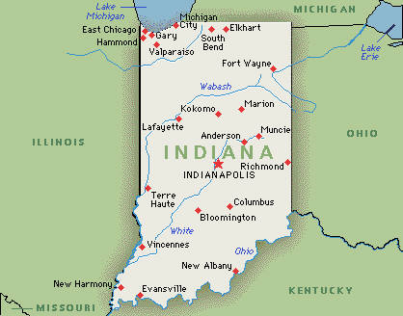
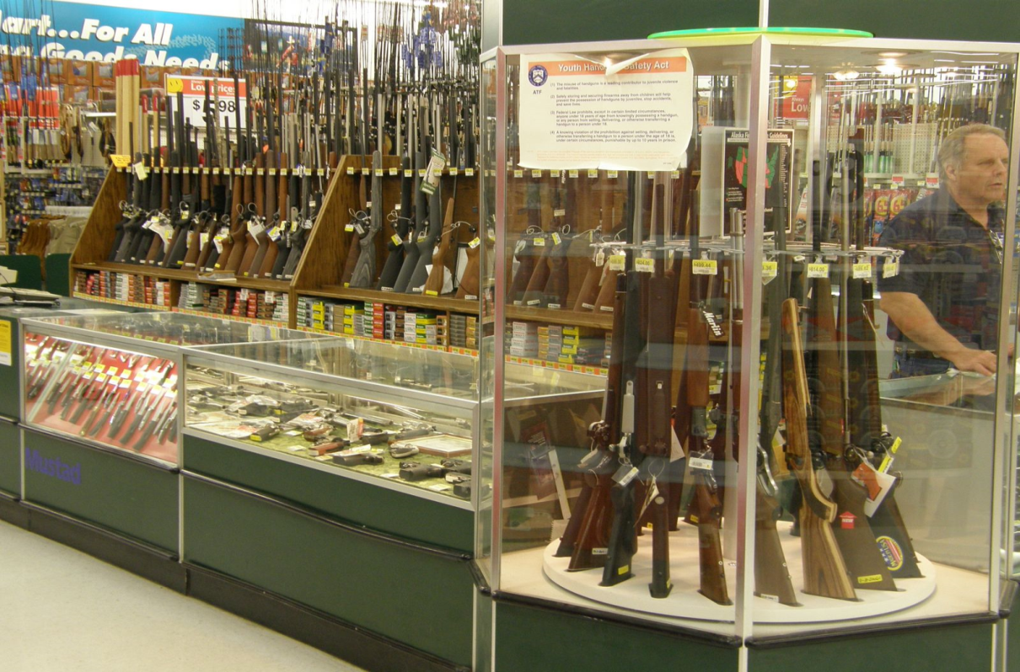
Questions?

