Slide 1
An Investigation in Pattern Recognition
Or, Why Can’t I Read My Statistics Notes?

Slide 2
Overview
Notes:
Jeff Cochran, Jason VanBuiten, and Michael Smith

Slide 3
How Do We Read?
More specifically, how does the brain recognize letters?
Pattern Recognition
How does pattern recognition in the brain work?
Could a mathematical or computer model be built to emulate the way the brain recognizes letters?

Slide 4
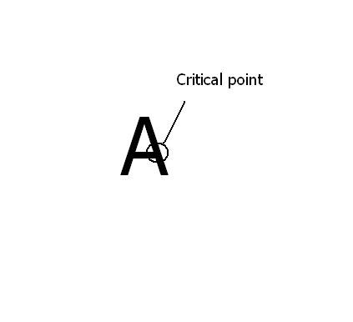
Critical Point Theory
Critical point theory is the theory our group is testing
It states that brain recognizes how lines in letters intersect, and stores representations of these “critical points”
When you see a letter, your brain compares the critical points to stored critical point patterns to identify the letter

Slide 5
Questions

Slide 6
Major Questions
Is this theory valid?
If it is, how powerful is it?
Can we create a mathematical model that can be used to accurately predict how difficult it is to read a letter?
Aside from critical point theory parameters, what other parameters would be useful to have in such a model?

Slide 7
Methodology

Slide 8
The Letter Sets
50 letters were drawn using an image editor
Ten were control, and were normal letters
Ten had critical points covered by “paint”
Ten were covered by “paint,” but the critical points were left uncovered
Ten had the critical point relative orientation “bent”
Ten letters were bent, but the critical point relative orientation was unchanged

Slide 9
The Experiment
People were shown these letters, and asked to name the letters
Response time, in seconds, was recorded by the experimenter
They were told explicitly that they don’t need to mention the case of the letter
Sample Critically Occluded Letter

Slide 10
Analysis

Slide 11
Data Divided into Two Analyses
Occlusion
Bend
Dependent Variable
Response Time
Explanatory Variables
Occlusion Type
Percent Occlusion
Frequency
Position
Points Occluded
Dependent Variable
Response Time
Explanatory Variable
Bend Type

Slide 12
Occlusion Set Analysis
Through ANOVA, it was found that occlusion type was indeed a significant predictor of response time
Through ANCOVA, it was shown that differences in occlusion percentage between occlusion types did not falsely suggest that the occlusion types were different
Through visual inspection and ANCOVA, it was shown that critically occluded points had overall higher reaction times than noncritically occluded points
A final model was derived through stepwise regression
Due to a lack of low occlusion percentage representation, occlusion percentage had an insignificant, negative “nonsense” coefficient, and was removed

Slide 13
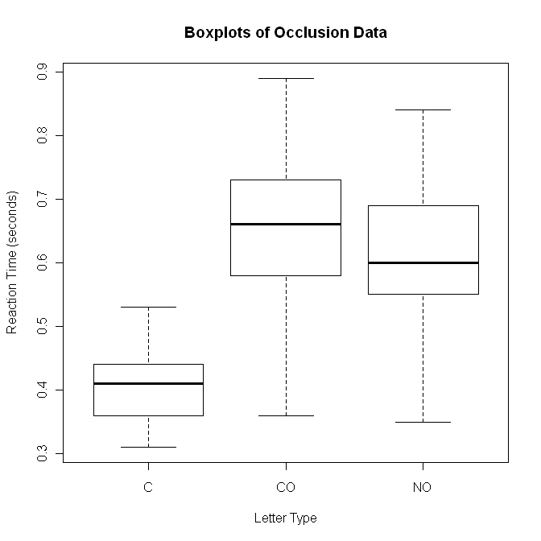
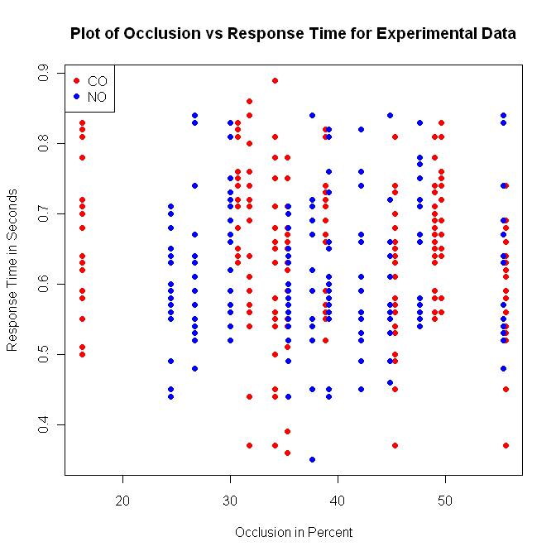

Slide 14
Bend Set Analysis
Unfortunately, we couldn’t devise a method of quantifying how bent a letter is in comparison to an unbent version of the same letter.
Do you have any ideas as to how we could do this?
Through ANOVA it was shown that bend type was a significant factor in predicting response time

Slide 15
Results and Discussion

Slide 16
Results
It was demonstrated that our critical point theory has statistical support
Although the model created is poor, from the outset this study was intended to be an initial, exploratory study
The study suffered somewhat from lack of difference across administrations of the experiment
If this was to be followed up, it would benefit from computer-generation of unique experiments
Overall, the theory was demonstrated to show real evidence of validity. It is safe to call the study a success

Slide 17
The frequency data used in this experiment was taken from an online source. A formal citation is available upon written request to Jeff Cochran, and will be included in the Project Part II write-up.

