Slide 1
Cars Going Green
RobinAzzam
AbhijitAmin
NirmalRajan
RichardSoni
JamisonAndaluz

Slide 2
Intro
Can we predict a car’s Green House Gas score?
Based on what factors?
Notes:
http://www.sciencedaily.com/images/2008/12/081204093041-large.jpg

Slide 3
Now Here is Abhjit
Why So serious?

Slide 4
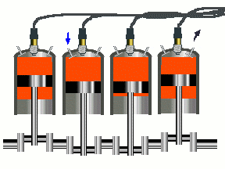
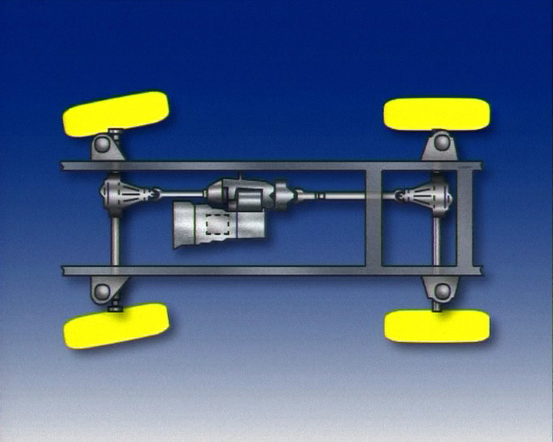
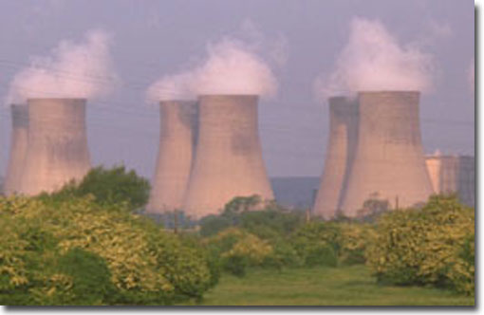
Our Data Set
CMB
MPG
Data Set
Car Model accompanied by data detailing the car and its green house scores
Source
Data.gov
Engine
Displacement
2-Wheel Drive
Or
4-Wheel Drive
Greenhouse Gasses
Air
Pollution
Score
Smart
Way
Notes:
http://www.treehugger.com/csm-cartoon-mpg-wallet-01.jpg

Slide 5
Now Here is Rich

Slide 6
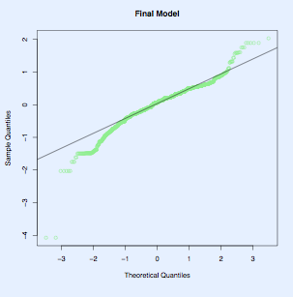
Method
Use a multiple linear regression
Choosing our initial model:
What to use as response?
What to use to explain?
Full model:
Cmb vs. Hwy & City Separate
0.9488 VS 0.9475
12 Variables
Final Model 0.9265 : Only 5 Variables

Slide 7
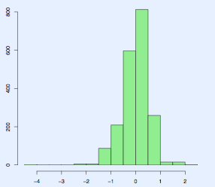
Residuals

Slide 8
Now Here is Jamison

Slide 9
ANOVA
VAR | F-Statistic
Cmb | 24470.550
Displ | 611.838
swyes | 78.469
4wd | 27.615

Slide 10
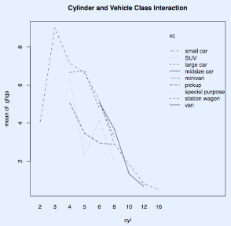
Discovering Interactions
Drive type and Vehicle type
2wd/4wd with smallcar/largecar/etc.
Drive type and Cylinder Count
Cylinder Count and Vehicle Type
These variables should be either included or left out together

Slide 11
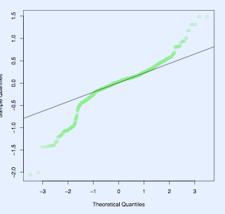
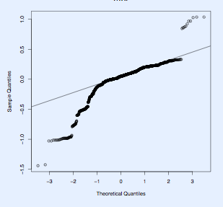
Failed Attempts
General Model : Poisson
Logged Values

Slide 12
Now Here is Robin

Slide 13
Conclusions
We can predict our Green House Gas Score’s with our model we constructed
Score reflects the amount of CO2 and
other greenhouse gasses.
Fuel Economy = Fuel Burnt
Ranges from 1-10

Slide 14
Conclusions
Air Pollution Score, Combined Miles Per Gallon, Smart Way Verification, Engine Displacement, and 4w/2w Drive effect Green House Gas Score more than any other variable.

Slide 15
Questions????

