Slide 1
What causes CRIME?
Ian Cordasco
Alaina Spicer
Tadas Vilkeliskis
Robert Williams

Slide 2
Source of Data
http://archive.ics.uci.edu/ml/datasets/Communities+and+Crime
Based on data from Department of Commerce, Bureau of Census and Department of Justice, Federal Bureau of Investigation

Slide 3
Why analyze crime?
Help law makers
Reduce crime
Devise solutions

Slide 4
Variables
Started with 124
13 significant – all numeric
~2000 rows
Crime to variables to communities

Slide 5
Model
ViolentCrimesPerPop ~
PctKids2Par-percentage of kids in family housing with 2 parents
HousVacant-number of vacant households
pctUrban-percentage of people living in areas classified urban
PctWorkMom-percentage of moms of kids under 18 in labor force
NumStreet-number of homeless people counted in the street
MalePctDivorce-percentage of males who are divorced
PctIlleg-percentage of kids born to never married
numbUrban-number of people living in areas classified as urban
PctPersDenseHous-percent of persons in dense housing(>1p/room)
raceptctblack-percentage of population that is african american
MedOwnCostPctIncNoMtg-median owners cost as a percentage of household income-for owners without a mortage
RentLowQ-rental housing-lower quartile rent
MedRent-median gross rent

Slide 6
Constructing Initial Model
Full model
  Not very good
Stepwise algorithm to select the best
  Reduction of variables to 38
  Still complex
  R-squared = 0.6773
Manual
  Pick most significant variables; only 14
  R-squared 0.6643

Slide 7
Hypothesis?
What variables do we think are related?
  percentage of kids born to never married
  percentage of people living in areas classified urban
Which do we expect not to be?
  percentage of moms of kids under 18 in labor force

Slide 8
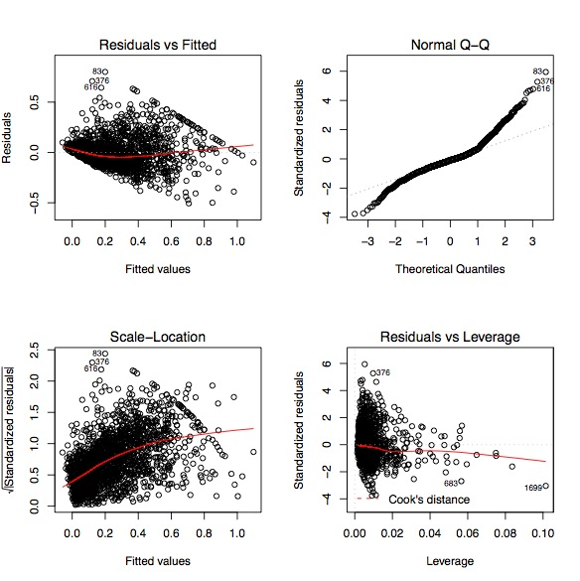
The Initial Model

Slide 9
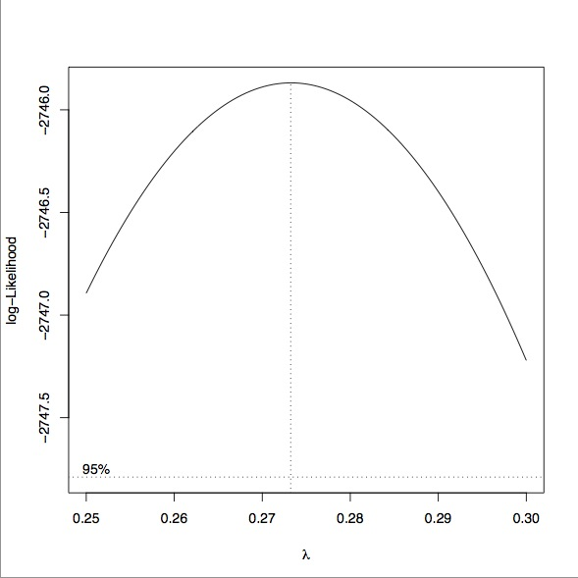
Improving the model (box cox)

Slide 10
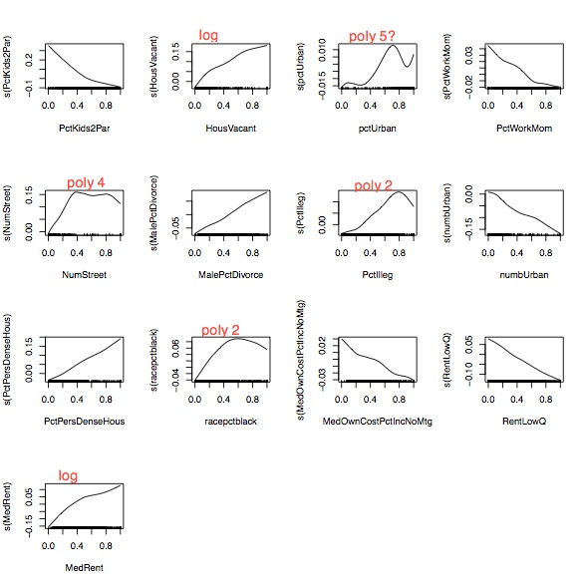
Improving the model (gam)

Slide 11
Variable transformation (1)
5th deg polynomial: pctUrban
3rd deg polynomial: NumStreet
2nd deg polynomial: PctIlleg, racepctblack
Logarithm: HousVacant, MedRent
=> R-squared: 0.6873

Slide 12
Variable transformation (2)
Same as previous
Log transformations to the rest of the variables
Increases significance
=> R-squared: 0.6742

Slide 13
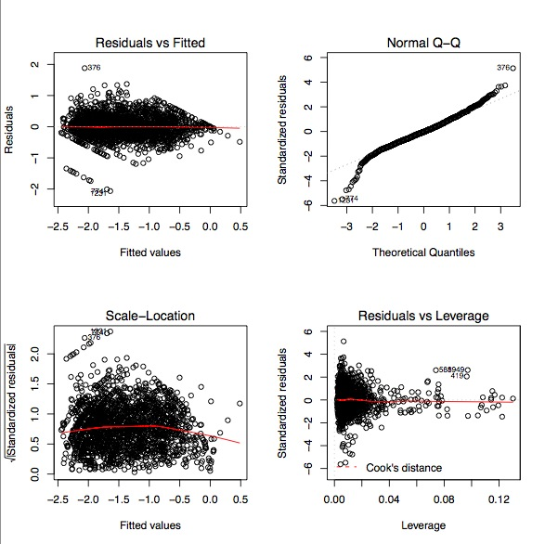
End result

Slide 14
Outliers
As you can see from the Q-Q plot and Residuals vs. Fitted, there are some outliers which R detects.
Since there are so many different kinds of cities and towns as observations, we decided to do a thorough analysis of outliers to make sure the model was not being adversely affected.

Slide 15
R-detected Outliers
R has an outlier test function outlierTest() which takes a model. These outliers were:
  Vernon, TX
  La Canada Flintridge, CA
  Glens Falls, NY
  Mansfield, TX
  West Hollywood, CA
  Plant City, FL
All relatively small population cities (between 10,000 and 50,000).
All very high violent crimes per population (> 0.83 standardized)

Slide 16
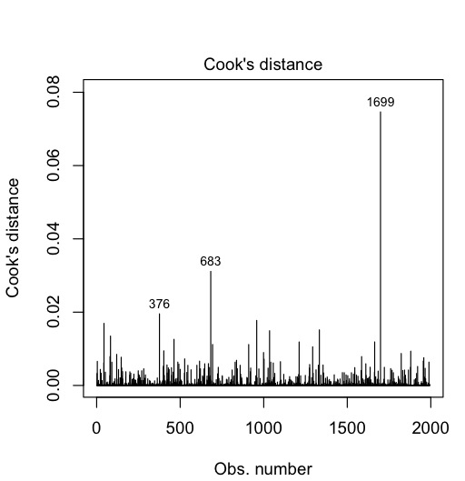
Cook’s Distance
Cook Distance shows the highly
influential data points:
376 – La Cañada Flintridge, CA
683 – Philadelphia, PA
1699 – Ft. Lauderdale, FL

Slide 17
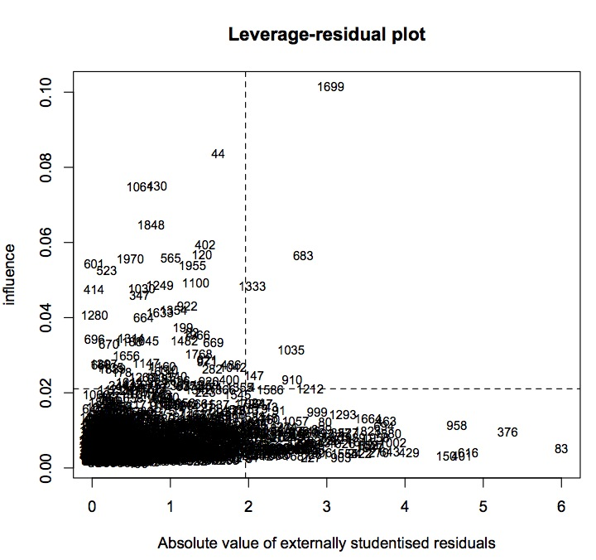
Leverage-Residual Plot (lrplot)
1333 – Ocean City, NJ
1035 – Gatesville, TX
These two are both relatively low
crime (< 0.10 standardized).
The other influential outliers
were defined in previous slides.

Slide 18
Outliers from lrplot
These are some influential outliers as identified by the top-right quadrant of the lrplot which weren’t in other output:
  Baton Rouge, LA
  Kansas City, MO
  Portland, TX
  Mission, TX
Top three are very high crimes (> 0.75)
Mission, TX has 0.06 crime, very low.

Slide 19
Does removing them help the model?
Removing all the outliers (total of ten) found with the methods in previous slides, the new model gets R^2 = 0.6899, compared with R^2 = 0.6711. Not a huge improvement. The residual graph also does not improve much.
Removing only the three influential outliers (from lrplot) results in R^2 = 0.6733.

Slide 20
Outliers Are Here To Stay
The mathematical and scientific community frowns upon indiscriminate removal of outliers.
We didn’t collect data.
Data was pre-standardized.
Removing the outliers doesn’t even help the model much.
Notes:
If we had collected the data, we could draw meaningful conclusions about why these data don’t fit the model very well. For example, maybe data measurement problems. But in this case, we did not get the data and so can’t draw these conclusions.
The data set was pre-standardized, so the data can’t be manually analyzed.

Slide 21
Our Preliminary Conclusions
The percent of persons living in dense housing is the most significant of the variables
Why?
  Dense housing is decided by more than 1 person living in each room

Slide 22
Preliminary Conclusions (cnt’d)
The percentage of the population that is African American is next
Why?
  Sociological reasons
    White flight
    Salary

Slide 23
Preliminary Conclusions (cnt’d)
Vacant Households & Children in two-parent Households
Why?
  Vacant households can indicate:
    Poor health conditions
    Foreclosure
  Two-parent households are stable.

Slide 24
Preliminary Conclusions (cnt’d)
Percentage of divorced males, Percentage of people living in urban areas, & Median gross rent
Why?
  We are uncertain about divorced males
  Higher percentages of people living in urban areas suggest denser housing
  Gross rent will be lower around dense housing

Slide 25
Preliminary Conclusions (cnt’d)
Number of homeless people, percentage of illegitimate children, & rental housing
Why?
  Mental, physical illness
  Two parents vs One parents
    Similar to, but not the same as, percentage of children with two parents.

Slide 26
Preliminary Conclusions (cnt’d)
Percentage of working mothers, number of people living in urban areas, & median owners cost of a household
Why?
  If mother is single, less time to monitor child?
  Eerily similar to percent of people living in urban areas, but important in the model
  Owners are likely tenants in urban areas

Slide 27
Our Working Conclusions
GAM Plots are awesome
Improved F-statistic
Improved AIC
Improved adjusted R²
Overall increasingly better model.

