Slide 1
Improvement
of the Superabsorbent Polymer Stability
Presenters: Dakota Baumann, Ian DiGuilio, Geoffrey Lim, Ravi Patel, Inna Petrusenko, Trent Reichert, and David Schulz
CHE 345: Process Control, Modeling, & Simulation
Professor Podkolzin
May 4, 2017

Slide 2
Outline
Patent Description
Objectives
Work Breakdown Structure
Process Variables
Safety Measures
Process Simulation
Conclusion and Recommendations
what’s goin’ on?

Slide 3
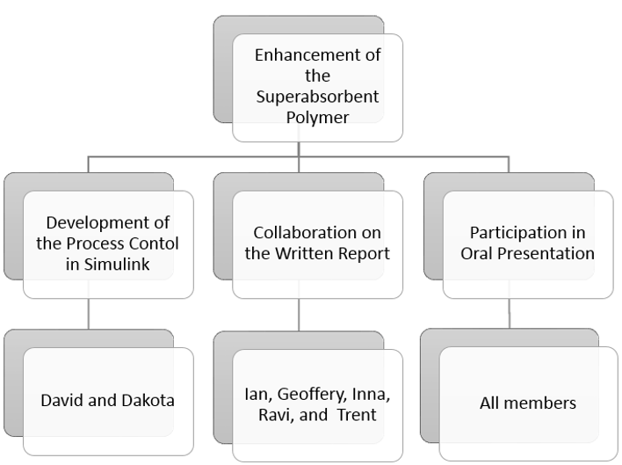
Work Breakdown Structure

Slide 4
Patent Description
Patent issued to Evonik Corporation in Parsippany NJ, for improving stability of the particulate superabsorbent polymer.
Used in infant diapers, child training pants, adult incontinence products, feminine products, and the like.
Major enhancements: increased Centrifuge Retention Capacity
1. Monomers, such as acrylic acid, are turned into the polymer as a water absorbing agent.
2. Surface treat by crosslinking the polymer matrix for additional absorption.
Process provides improved absorption capabilities, resistance to damage, all while increasing economic benefits.

Slide 5
The Modeled Reaction
Polymerization Rxn:
Step 1 - Neutralization of Acrylic acid by addition of Sodium Hydroxide

Slide 6
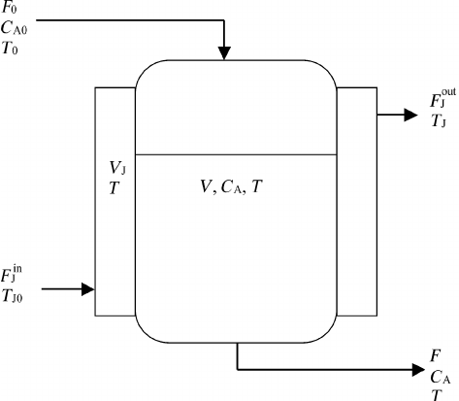
Process Model
Modeled the 1st step of polymerization of acrylic acid in
a CSTR Reactor
Reaction occurs in two steps:
1. Neutralization of acrylic acid to form a monomer
2. Radical is added to the monomer which causes polymerization
In addition to the CSTR, a heating and cooling system is required

Slide 7
Objectives
Current superabsorbent polymers face premature leakage and skin wetness due to low centrifuge retention capacity (CRC)
Keep the temperature below 150 °C to ensure concentration of monomer radical in product
High temperatures lead to prolific cross-linking which will lead to decreased product concentration
Monitor concentration of acrylic acid in product stream to verify product meets final specifications

Slide 8
Process Variables
Controlled Variables: all the things kept the same in the experiment
Concentration of reactant in exit stream
Temperature of the reaction
Manipulated Variables: the variables we change in the experiment
Reactant flow rate
Coolant flow rate
Disturbance Variables: an input that affects the process but cannot be adjusted by the control system
Initial reactant concentration
Coolant Temperature

Slide 9
Safety Measures
Temperature monitored and maintained below 150 °C
All fumes produced from the polymerization process are passed through a treatment unit before discharged into the atmosphere.
Water used to cool is recycled back to the cooling towers.
Process water is thoroughly treated before released into the environment.

Slide 10
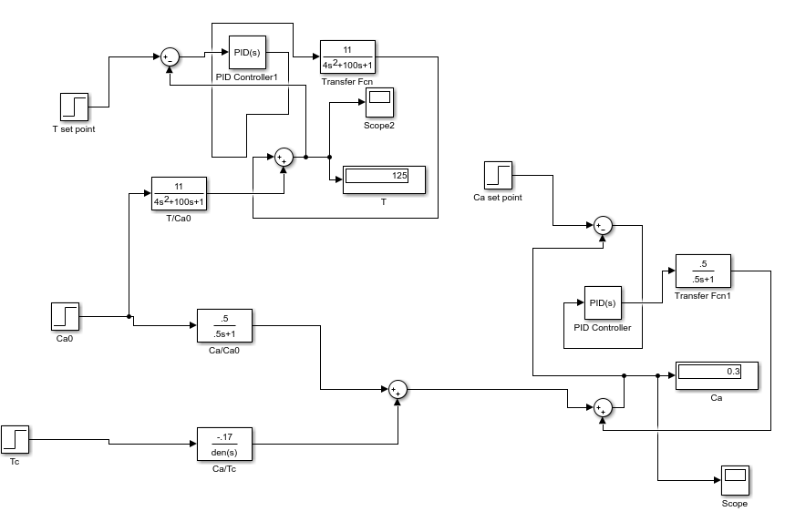
Simulink Model
Temperature set point = 125 °C
Concentration set point = 0.3 $\frac{\text{mol}}{\text{m}\text{3}}$

Slide 11
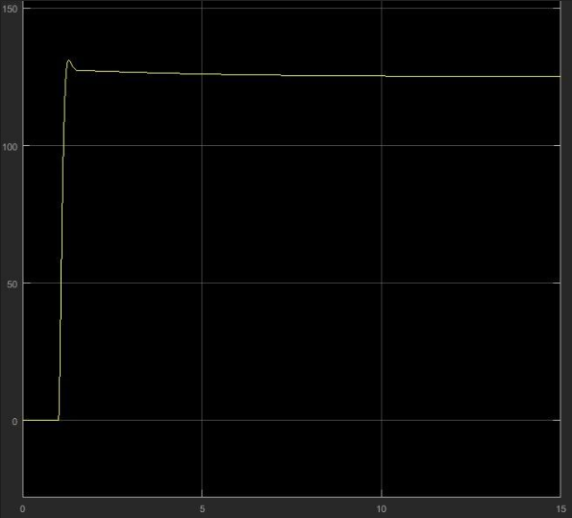
Temperature Response Graph
Temp. [°C]
Time [min]

Slide 12
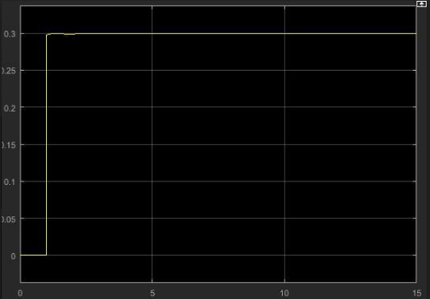
Concentration Response Graph
Conc. [mol/m³]
Time [min]

Slide 13
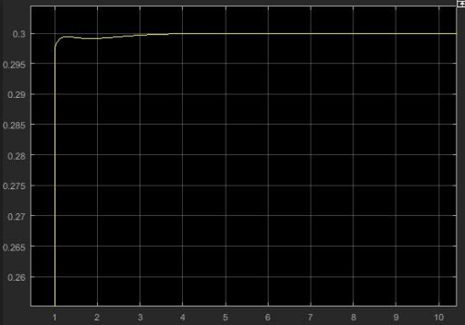
Concentration Response Graph
Conc. [mol/m³]
Time [min]

Slide 14
Conclusions
Models can be used to develop, modify, and control chemical processes
Useful for ensuring desired product
Economically favorable
Transfer functions help model differential equations
Room for improvement:
Communication - difficult to meet; big group
Management - mostly independent; adhere to WBS

